Slide 1
Digitizing Medieval Texts
Programming for Humanists
Katayoun Torabi, Texas A&M University
August 26, 2016

Slide 2
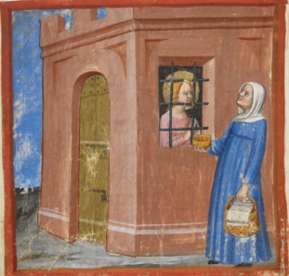
St Margaret in prison being visited by her godmother, from Tectino’s Life of St Margaret of Antioch in verse, Italy, 15th century, Harley MS 5347, f. 26v

Slide 3
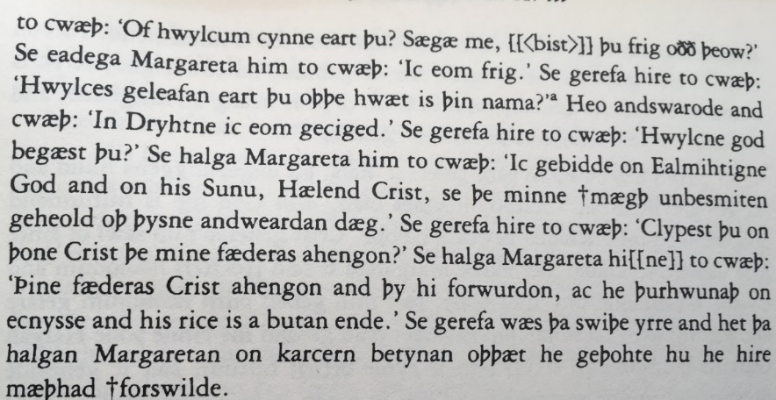
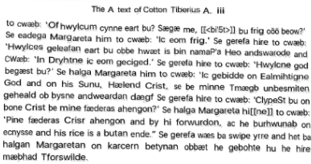
Image
From the Old English Life of St. Margaret in the A-text of the Cotton Tiberius A iii MS
Text

Slide 4
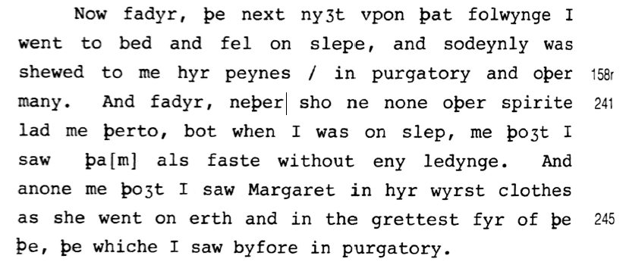
From A Revelation of Purgatory by an Unknown Fifteenth-Century Woman Visionary: Introduction, Critical Text, and Translation, Studies in Women and Religion 18 (Lewiston, NY 1985)

Slide 5
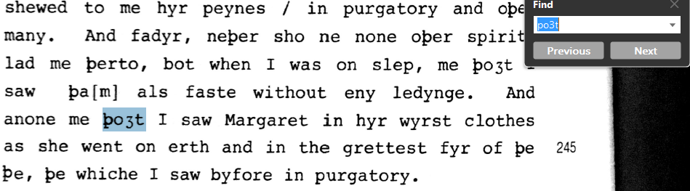
From A Revelation of Purgatory by an Unknown Fifteenth-Century Woman Visionary: Introduction, Critical Text, and Translation, Studies in Women and Religion 18 (Lewiston, NY 1985)

Slide 6

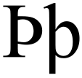
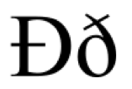
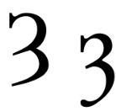

Slide 7
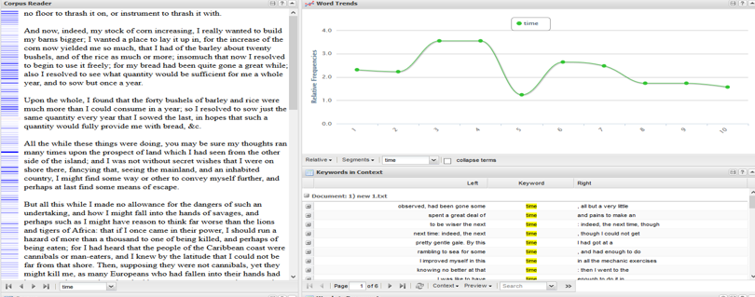
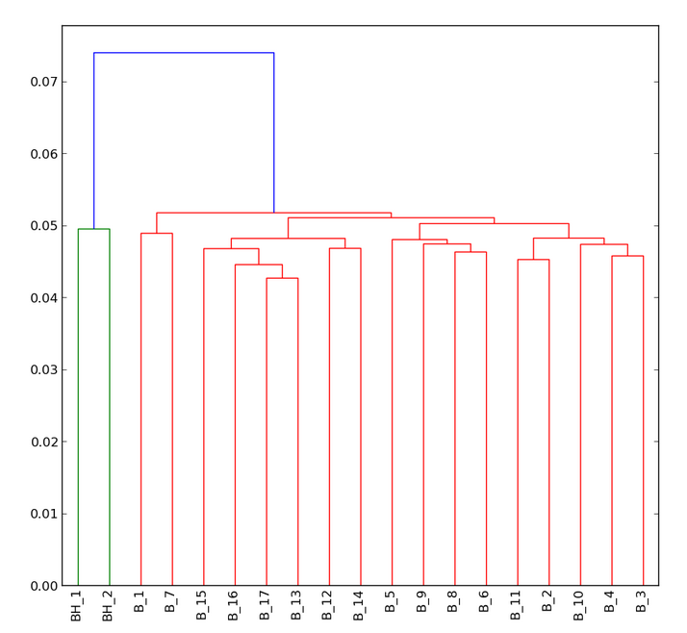
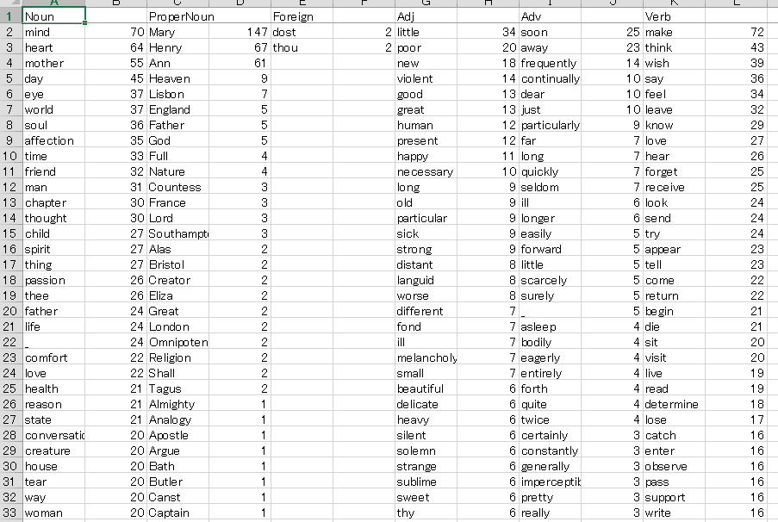
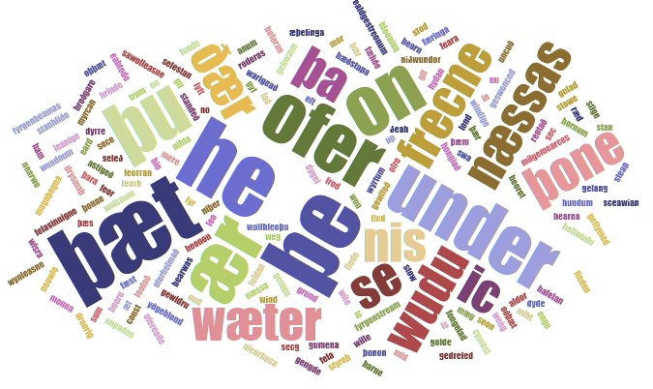
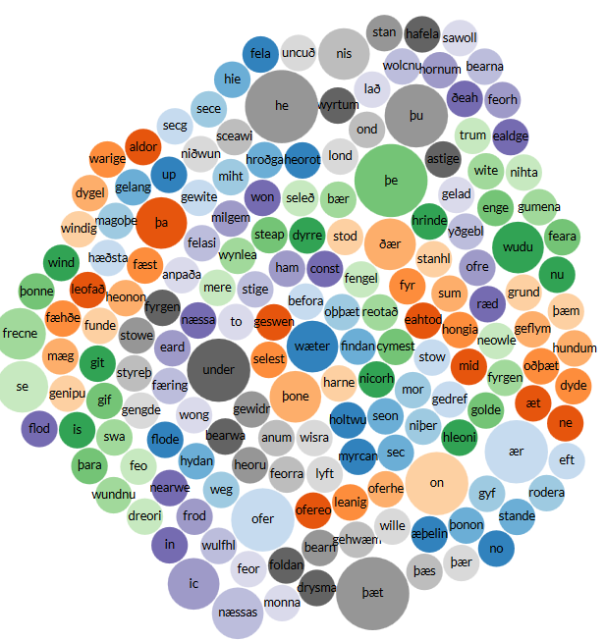
Higuchi, Koichi. KH Coder. 2014. http://khc.sourceforge.net/en/
Stéfan and Rockwell, Geoffrey. Voyant Tools. 2014. http://voyant-tools.org/
Kleinman, S., LeBlanc, M.D., Drout, M. (2015). "Lexomics Tools." (http://lexomics.wheatoncollege.edu).

